Slide 1




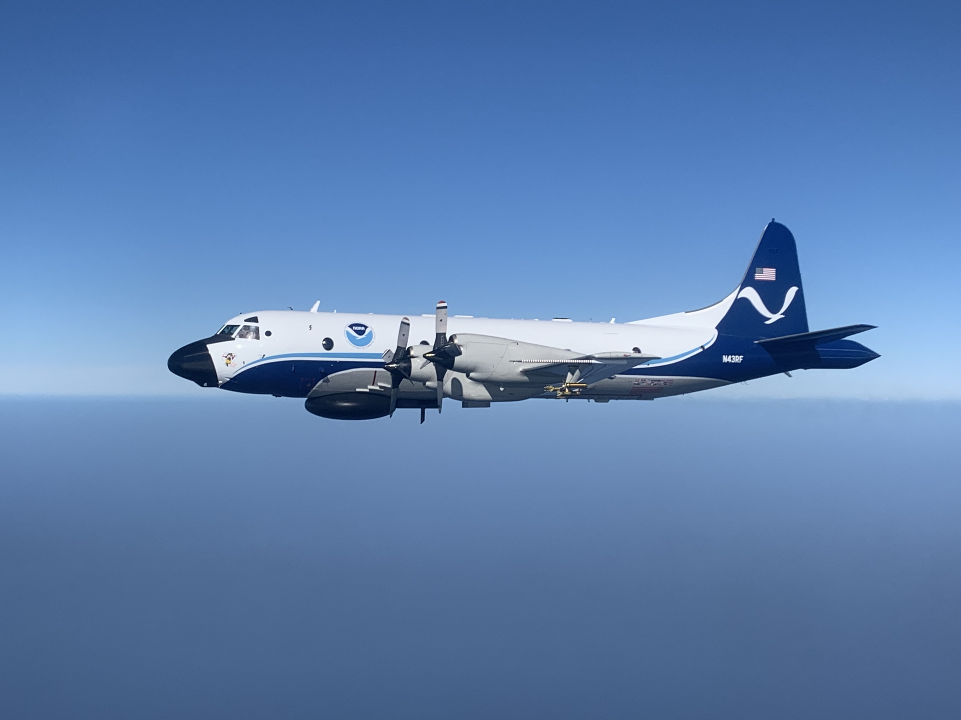
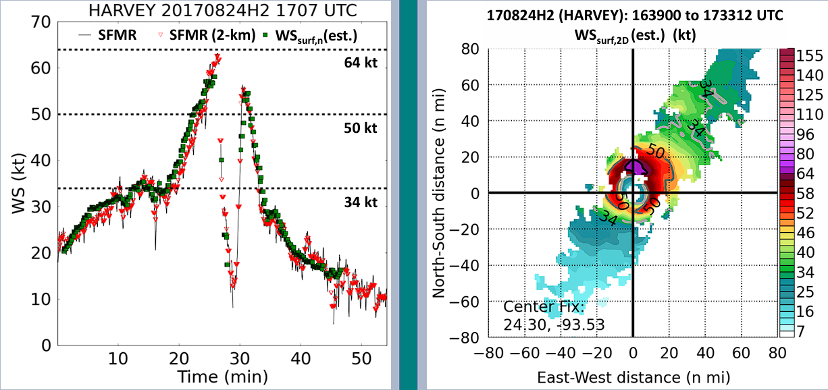
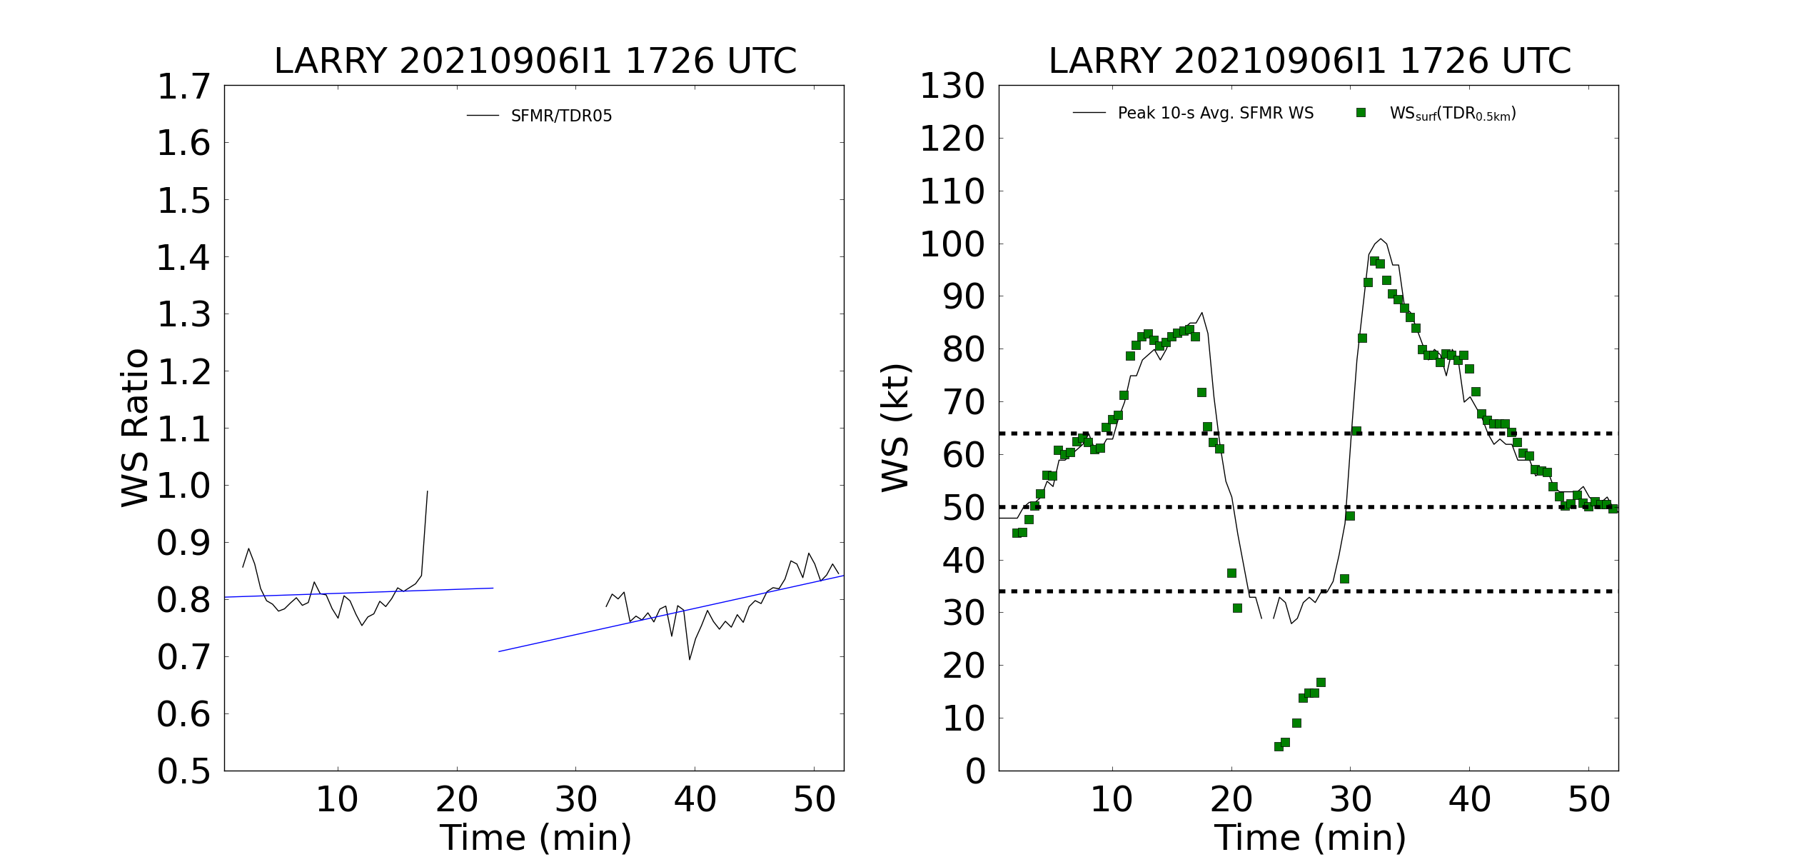
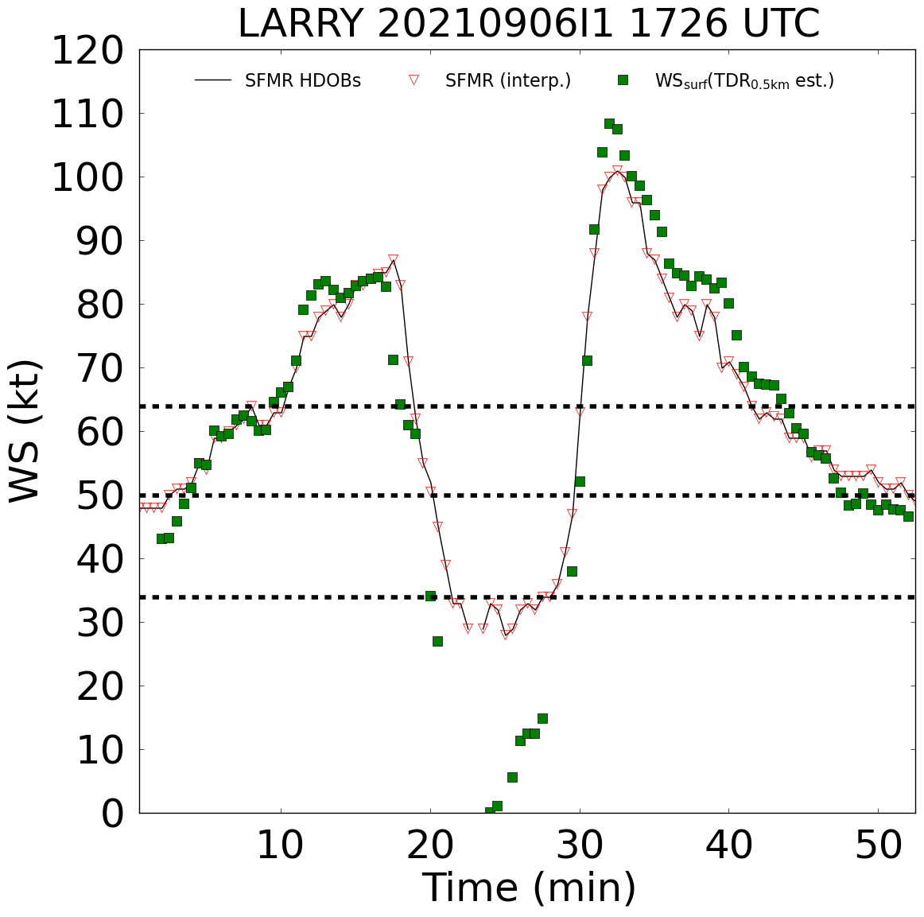




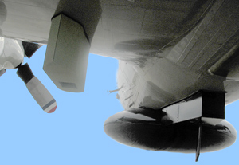

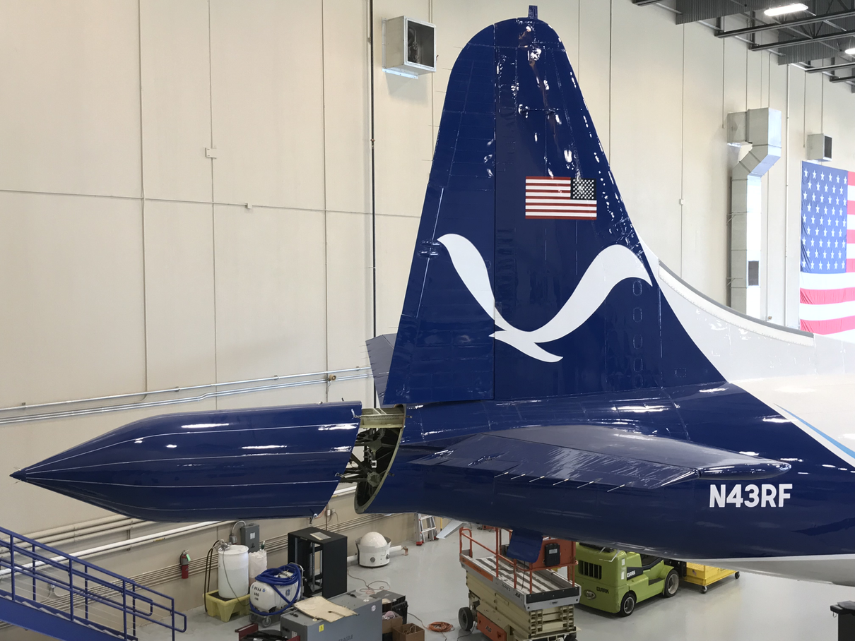
Intercalibration of SFMR and Tail Doppler Radar Estimates of 10 Meter Mean Winds and One Minute Maximum Winds
${\text{Maggie} \text{Zoerner} }^{1,2}$, ${\text{Mark} \text{Bourassa} }^{1,2}$, ${\text{Heather} \text{Holbach} }^{2, 3,4}$
$^{1}$ Florida State University Department of Earth, Ocean, and Atmospheric Science, Tallahassee, USA
$^{2}$ Florida State University Center for Ocean-Atmospheric Prediction Studies, Tallahassee, USA
$^{3}$ Florida State University, Northern Gulf Institute, Tallahassee, USA
$^{4}$ NOAA/AOML/HRD, Miami, USA
03. Objective
04. Challenges
06. Approach
  Variations in observation height, spatial resolution, and temporal resolution between the two instruments.
  SFMR measurements are surface-focused, while TDR measurements are volume-focused.
  Spatial and temporal averaging may smooth local variations in winds that are significant for the determination of one-minute maximum winds.
1. Develop calibration model to relate TDR winds and SFMR winds
  Adjust TDR winds to surface level.
  Utilize linear regression, point-to-point reduction, or machine learning models to correct biases and intercalibrate TDR estimates with SFMR estimates.
2. Determine one-minute maximum winds
  Aggregate the intercalibrated SFMR and TDR data into one-minute intervals.
  Identify the maximum wind speed within the one-minute intervals.
3. Validation and verification
  Cross-validate with additional observations where available.
Provide an intercalibrated one-minute maximum wind using both TDR and SFMR estimates.
NOAA P3
01. Background
05. Intercalibration
  One-minute maximum wind: peak one-minute wind at the standard meteorological observation height of 10m.
  The SFMR and TDR utilize different methods to retrieve wind data along the flight path during aircraft reconnaissance missions.
  Intercalibration between the two instruments is required to obtain more reliable estimates of the one-minute maximum winds.
Accurate derivation of one-minute maximum winds requires intercalibration between the two instruments to improve reliability and correct bias.
02. Instrumentation
Bias-corrected surface wind speed: 70kt
Operational wind speed: 75kt
Stepped Frequency Microwave Radiometer (SFMR): Retrieves surface wind speed by measuring the surface brightness temperature.
(Reasor, Holbach, and Gamache, 2021)
SFMR
07. Summary
NOAA/AML
TDR
Motivation: Data used with increased confidence by operational users.
Goal: Provide intercalibrated one-minute maximum wind estimates using TDR and SFMR data.
Approach: Develop a calibration model and determine one-minute maximum winds from intercalibrated SFMR and TDR data.
Tail Doppler Radar (TDR): X-band radar that measures near-vertical cross-sections of winds behind the aircraft.
NOAA/AML
Best-fit reduction factor (blue)
Point-to-point reduction factor method
Linear bias-correction method
(Paul Reasor, 2022)
Acknowledgements
We thank NOAA, COAPS, and NASA for funding this work.

